Slide 1

A a

Slide 2


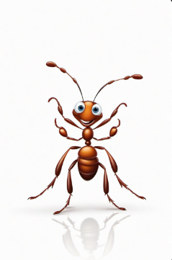
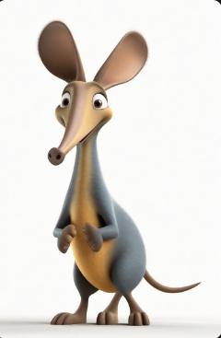

A a

Slide 3
A a

Slide 4

A a

Slide 5

B b

Slide 6


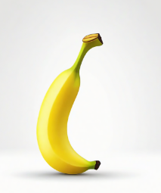

Slide 7


Slide 8



Slide 9


Slide 10
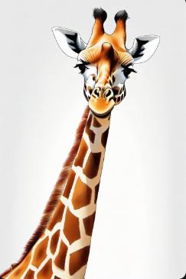


Slide 11


Slide 12


Slide 13
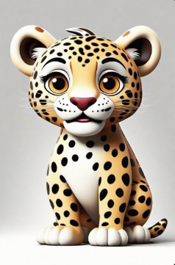

Slide 14



Slide 15


Slide 16


Slide 17
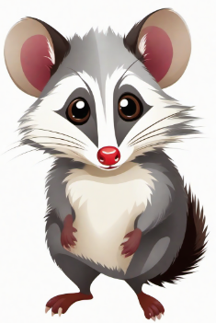

Slide 19


Slide 20




Slide 21

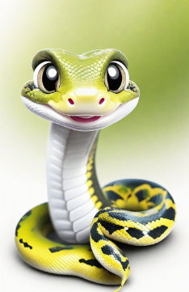

Slide 22

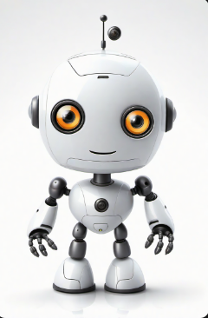


Slide 24

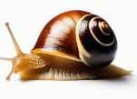


Slide 25



Slide 26
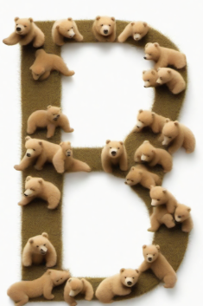



Slide 27



Slide 28
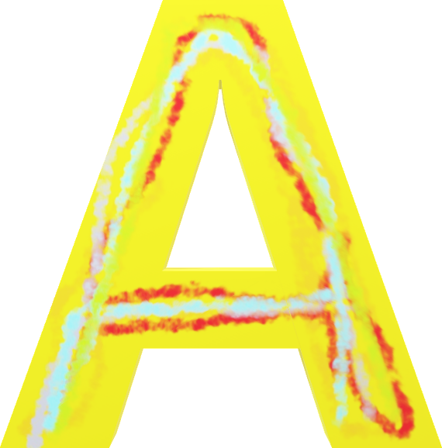

Slide 29
ABCDEFGHIJKLMNOPQRSTUVWXYZ

